Slide 1
WELCOME TO PHYSICAL EDUCATION
GOALS IN PHYSICAL EDUCATION:
To learn a variety of physical activities/sports
Improve overall health and personal fitness
Have fun trying new things!!

Slide 2

NORTHERN MIDDLE SCHOOL
PHYSICAL EDUCATION
All students have PE 2 times per cycle all year
It's either....
Days 1 & 4
Days 2 & 5
Days 3 & 6

Slide 3


BOYS LOCKER ROOM
Entering Boys Locker Room....
Enter from hallway door across from Boys Restroom
Go up stairs
Select Day locker
Change clothes
Line up at opposite end of locker room
When told, students will go down stairs at far end of locker room to gym
End of class…. Students wait at door behind sign until dismissed by teacher [usually whistle]

Slide 4
LOCKEROOM RULES
Keep clean ...no garbage, grass & clothes on floor
Hands off others belongs.... clothing, shoes locks, books...etc
No Running
No Food or Drinks
No Gum in PE at any time
Do not get IN or ON lockers
No cell phone
Computer Care
Destruction of school Property unacceptable!!

Slide 5


PE
ATTENDANCE PROCEDURES
Students immediately sit in Attendance Rows on Gym Floor
During attendance... students may talk quietly

Slide 6
PHYSICAL EDUCATION DRESS REQUIREMENTS
Students must wear....
Shorts or Sweatpants [ No jean shorts or cutoffs of any kind]
T-Shirts [short sleeve or long sleeve] [avoid tank tops and cut offs]
Sneakers & Socks [extra pair for outside if needed due to wet grass]
No flip flop, sandals, shoes...etc
No Hats
Swim suit and towel will be needed for 6th & 7th Grade Swim Unit
NOTE...
Cannot wear school clothes for PE, even if proper attire !!

Slide 7

DRESS APPROPRIATELY FOR WEATHER CONDITIONS
Warm Weather or Cold Weather

Slide 8


Additional PE Preparation Information...
Deodorant Use .... Strongly recommended
YES NO
No aerosol spray cans allowed
No large jewelry
Again...No Gum

Slide 9



PHYSICAL EDUCATION GRADING
3 Categories...
Participation / Preparation / Behavior
= Typically 5 Points Each Class
Skill Assessments [Students demonstrate 1-2 basic skills from Unit]
= Typically 5 Points Each Skill
Knowledge Assessments [ Examples...Quiz, Writing Prompt, Reflections]
= Typically 10 Points

Slide 10
PREPARATION & PARTICIPATION
- Lose 5 points each class you do not have proper PE clothes
- 3 no dresses = letter home to be signed by parents
- 4+ no dresses = 10 points off grade each time thereafter
[ per semester, not marking period ]

Slide 11


SAMPLE UNIT GRADE CALCULATION
SOCCER UNIT
Grade Category Possible Points Points Earned
Participation/Preparation/Behavior 30 23
Skill Check Assessment [2 skills= dribble & trap] 10 10
Quiz or Writing Prompt 10 9
50 42 = 84% C

Slide 12
PHYSICAL EDUCATION MEDICAL EXCUSES
- All medical / parent excuses MUST be taken to Mrs. Strouse, school nurse!
Not Mr. Robison or Mrs. Rucker!
Mrs. Strouse will keep your excuse on file and write a PE Medical Pass for you to give to teacher. ( Mr. Robison or Mrs. Rucker)
For extended Medical Excuses, written assignments will be given to student.

Slide 13
CLASS BEHAVIOR EXPECTATIONS
R E S P E C T
[ Teachers – Classmates – School Property – Others Belongings! ]
No talking while teacher is speaking!
You will be treated as you act!
Treat Others As YOU Wish To Be Treated !

Slide 14
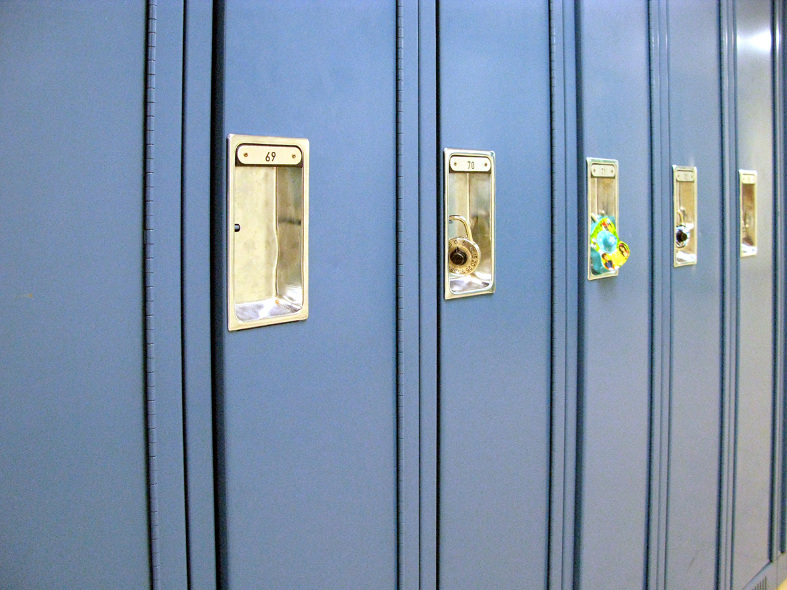
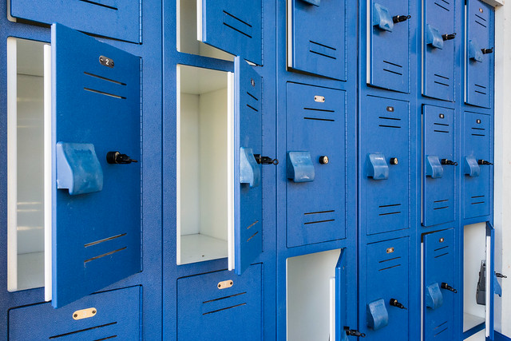
PE LOCKER
ASSIGNMENTS
Combination Locks only [approved & registered with PE Teacher]
Will have locker for entire year
Long lockers and empty small lockers may be used for day use….
…. but items may not be left in lockers overnight.
You are responsible for lost items [lost and found bin in locker Room]

Slide 15

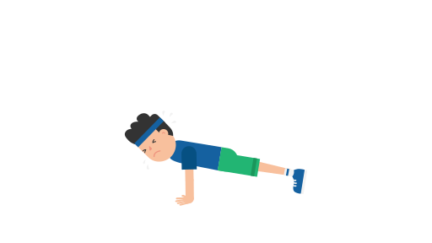
PHYSICAL EDUCATION CURRICULUM
WHAT ARE YOU DOING THIS YEAR?
Classes will typically begin with General Strength & Cardio Exercise
Physical Education Units

Slide 16
8th grade Physical Education Curriculum
Girls Boys
Lacrosse Ultimate Sports
Field Hockey Lacrosse
Coed Volleyball Coed Pickleball
Coed Pickleball Coed Volleyball
Fitness Center Basketball
Coed Team Building Coed Team Building
Fitness Testing Fitness Testing
Coop Activities Coop Activities
Basketball Strength Training
Mile Run Mile Run
Track and Field Track and Field

Slide 17
7th Grade Physical Education Curriculum
Girls Boys
Soccer Football
Ultimate Sports Intro to Lacrosse
Basketball Strength & Conditioning
Strength & Conditioning Basketball
Team Handball Team Handball
Coed Team Building Coed Team Building
Swimming Fitness Testing
Fitness Testing Swimming/Canoeing
Intro to Lacrosse Indoor Soccer
Fitness Test-Mile Run Fitness Test-Mile Run
Create a Game Create a Game

Slide 18
6th Grade Physical Education Curriculum
Girls Boys
Soccer Intro to Football
Field Hockey Intro to Soccer
Coed Volleyball Coed Pickleball
Coed Pickleball Coed Volleyball
Fitness Center Intro to Basketball
Coed Team Building Coed Team Building
Swimming Fitness Testing
Fitness Testing Swimming
Basketball Fitness Center
Fitness Test-Mile Run Fitness Test-Mile Run
Track and Field Track and Field

